Slide 1
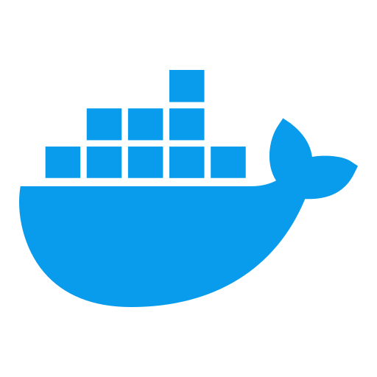
Module 9: Docker Volume Management & Data Persistence
Docker & Containerization Workshop
By TALHA

Slide 2
Learning Objectives
Implement enterprise-grade data persistence strategies
Master Docker volume management for stateful applications
Apply backup and recovery best practices for containerized data

Slide 3
Docker Storage Architecture
Storage Drivers: Manage image layers and container writable layer
Volumes: Independent storage outside container lifecycle
Mounts: Connection points between containers and storage

Slide 4
Storage Driver Types
overlay2: Default, most widely used
Union filesystem for layers
Efficient for most workloads
devicemapper: Block-level storage (legacy)
Better for high write workloads
Requires direct-lvm mode for production
btrfs/zfs: Advanced filesystem features
Snapshots, compression
Higher resource requirements
Selection Criteria
Performance needs
Host OS compatibility
Stability requirement

Slide 5
Volume Types and Use Cases
Named Volumes
# Create named volume
docker volume create data-volume
# Use named volume
docker run -v data-volume:/data nginx
Managed by Docker
Persistent lifecycle
Best for most data persistence needs
Bind Mounts
# Use bind mount
docker run -v /host/path:/container/path nginx
Access specific host directory
Good for development
Direct access to host filesystem
tmpfs Mounts
# Use tmpfs
docker run --tmpfs /app/temp nginx
In-memory storage
Sensitive data that shouldn't persist
High-performance temporary storage

Slide 7
Data Persistence Patterns
Stateful vs. Stateless Containers
Stateless: No persistent data (preferred)
Stateful: Requires data persistence
State Externalization Strategies
Database containers with volume mounts
Shared storage for replicated services
Cache with data rehydration capabilities
Transaction Consistency
Write-ahead logging
Atomic operations
Crash recovery mechanisms

Slide 8
Volume Creation and Configuration
Basic Volume Creation
# Create simple volume
docker volume create my-data
# Create with labels
docker volume create --label project=nadra --label env=prod doc-data
Volume Driver Selection
# Create volume with specific driver
docker volume create --driver local \
--opt type=nfs \
--opt o=addr=192.168.1.1,rw \
--opt device=:/path/to/dir \
nfs-volume
Access Control
# Set ownership in container
docker run -v data-volume:/data --user 1000:1000 nginx

Slide 9
Enterprise Storage Integration
NFS Volume Configuration
# Create NFS volume
docker volume create --driver local \
--opt type=nfs \
--opt o=addr=192.168.1.1,rw \
--opt device=:/path/to/dir \
nfs-volume
SAN/Block Storage
iSCSI integration
Direct LUN attachment
Performance considerations
Cloud Provider Volumes
# Create AWS EBS volume (with Docker plugin)
docker volume create --driver aws-ebs \
--opt size=20 \
--opt volumetype=gp2 \
aws-ebs-volume

Slide 10
Performance Optimization
I/O Performance Benchmarking
# Install tools in container
docker run -it --rm --volume \ data-volume:/data ubuntu bash
apt-get update && apt-get install -y fio
# Run benchmark
fio --name=benchmark --rw=randwrite --bs=4k --size=1G --directory=/data
Volume Caching Strategies
Delegate caching to filesystem
Add memory-based cache layer
Application-level caching
Read/Write Optimization
Separate volumes for different I/O patterns
Right-size block devices
Consider separate read-only volumes

Slide 11
Volume Backup Strategies
Consistent Backup Methodology
# Stop container during backup
docker stop my-container
# Backup volume to tar file
docker run --rm -v my-volume:/data -v $(pwd):/backup \
alpine tar czf /backup/volume-backup.tar.gz /data
# Restart container
docker start my-container
Backup Automation
# Using docker-volume-backup container
docker run -d \
-v /var/run/docker.sock:/var/run/docker.sock \
-v /path/to/backups:/backups \
-e BACKUP_CRON_EXPRESSION="0 2 * * *" \
loomchild/volume-backup

Slide 12
Volume and Execution Instructions
Point-in-Time Recovery
# Restore volume from backup
docker run --rm -v my-volume:/data -v $(pwd):/backup \ alpine sh -c "rm -rf /data/* && tar xzf /backup/volume-backup.tar.gz -C /"
Recovery Time Objective (RTO)
Volume restore strategies
Replica promotion
Failover procedures
Data Integrity Verification
# Verify backup integrity
docker run --rm -v $(pwd):/backup \
alpine sh -c "tar tzf /backup/volume-backup.tar.gz > /dev/null && echo 'Backup is valid'"

Slide 13
Volume Migration Techniques
Cross-Host Migration
# Export volume
docker run --rm -v my-volume:/data -v $(pwd):/backup \
alpine tar czf /backup/volume-data.tar.gz -C /data .
# Import on target host
docker volume create my-volume docker run --rm -v my-volume:/data -v $(pwd):/backup \
alpine sh -c "tar xzf /backup/volume-data.tar.gz -C /data"
Environment Migration
Dev → Test → Prod volume promotion
Data sanitization during migration
Schema version compatibility
Upgrade and Rollback
Volume snapshot before upgrade
Compatibility testing
Rollback strategy documentation

Slide 14
Docker Compose Volume Configuration
version: '3.8'
volumes:
db-data:
driver: local
driver_opts:
type: none
device: /data/postgres
o: bind
document-storage:
external: true
services:
db:
image: postgres:14
volumes:
- db-data:/var/lib/postgresql/data
- ./init-scripts:/docker-entrypoint-initdb.d:ro
app:
image: doc-analysis-app
volumes:
- document-storage:/app/documents
- type: tmpfs
target: /app/temp

Slide 15


Slide 16
Security Considerations for Volumes
Access Control
Proper file ownership and permissions
Non-root container users
Read-only mounts when possible
Sensitive Data Handling
Encrypted volumes
Temporary storage for secrets
Secure deletion practices
Audit and Compliance
Volume access logging
Immutable audit logs
Compliance requirements for data storage

Slide 17
Document Analysis System Volume Requirements
Document Storage Volumes
Source documents (input)
Processed results (output)
Model data (read-only)
Performance Requirements
High-throughput document ingestion
Parallel processing capabilities
Adequate I/O for batch operations
Backup Requirements
Regular snapshots
Document retention policies
Incremental backup strategy

Slide 18
Hands-on Exercise: Volume Management for Document Analysis
Exercise Objectives
Implement named volumes for document storage
Configure persistence for OCR and NLP models
Test data persistence across container restarts
Steps
Create volume structure for document analysis system
Configure containers with appropriate volume mounts
Process sample documents and verify data persistence
Test container recreation without data loss
Implement volume labeling and organization strategy

Slide 19
Hands-on Exercise: Backup and Recovery Implementation
Exercise Objectives
Create consistent backups of document storage volumes
Implement point-in-time recovery
Simulate disaster recovery scenarios
Steps
Develop backup script for document volumes
Test full and incremental backup strategies
Simulate data corruption and perform recovery
Document backup and recovery procedures
Implement automated backup solution

Slide 20
Key Takeaways
Proper volume management is critical for stateful containers
Different volume types serve different use cases
Enterprise deployments require integration with existing storage
Backup and recovery strategies must be tested regularly
Security and performance considerations should be balanced

Slide 21

Questions?

